Slide 1


SUBVERSION
Presented by:
Nandini Srivastava
500105220
R2142220576

Slide 2
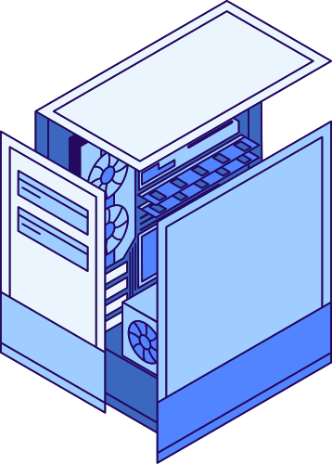

DEFINITION
Apache Subversion (SVN) is a centralized version control system that facilitates efficient management of project files and directories over time. It enables developers to track changes, revert to previous versions, and collaborate seamlessly.

Slide 3
INTRODUCTION TO SUBVERSION
A centralized version control system developed by the Apache Software Foundation.
Used to maintain current and historical versions
KEY FEATURES INCLUDE:
Centralized Version Control: All files are stored in a central repository, making it easy to manage.
Atomic Commits: Ensures that either all changes are committed or none, preventing partial updates.
Efficient Handling of Binary Files: Stores binary files effectively without unnecessary duplication.
Branching and Merging: Supports parallel development by allowing teams to work on different branches.
Access Control: Permissions can be set at directory levels to restrict access.

Slide 4
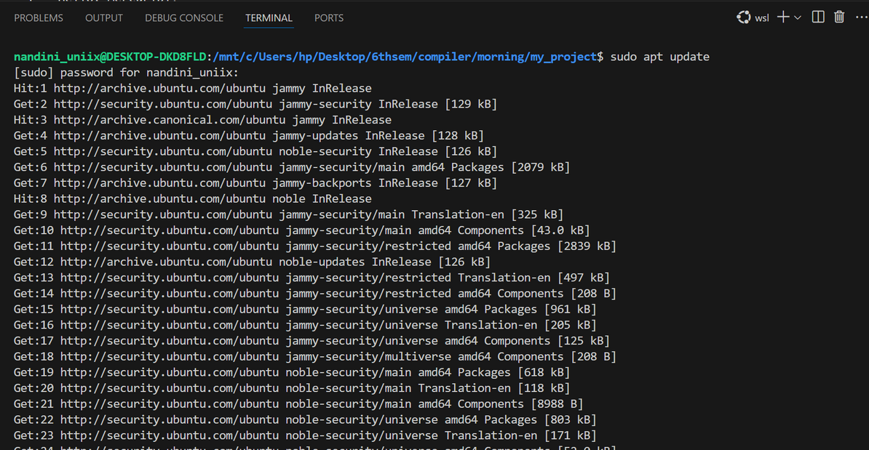
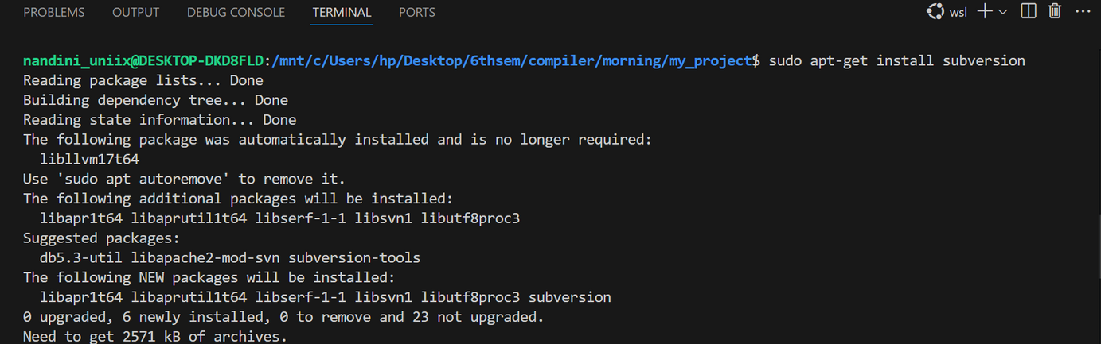
INSTALLATION
LINUX: wsl command:
sudo apt update
sudo apt-get install subversion
sudo apt-get install libapache2-mod-svn

Slide 5
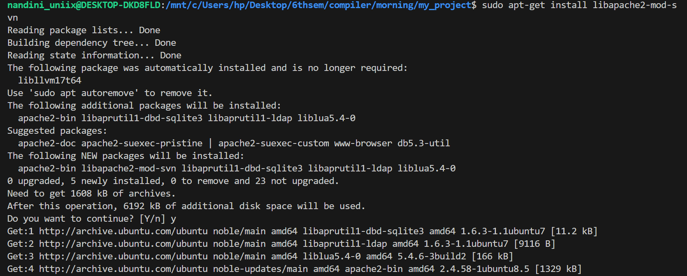

Slide 6
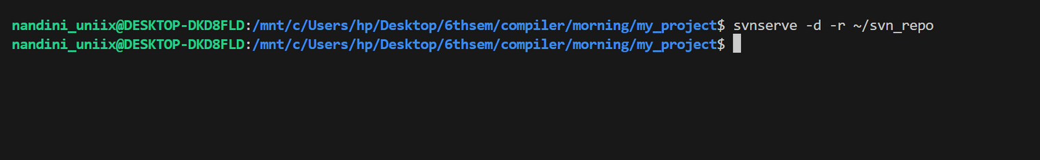
Workflow Example
Set up an SVN repository
Create a Local Repository
mkdir ~/svn_repo
2. Initialize Repo
svnadmin create ~/svn_repo/my_project
Start SVN Server (Optional)
svnserve -d -r ~/svn_repo

Slide 7
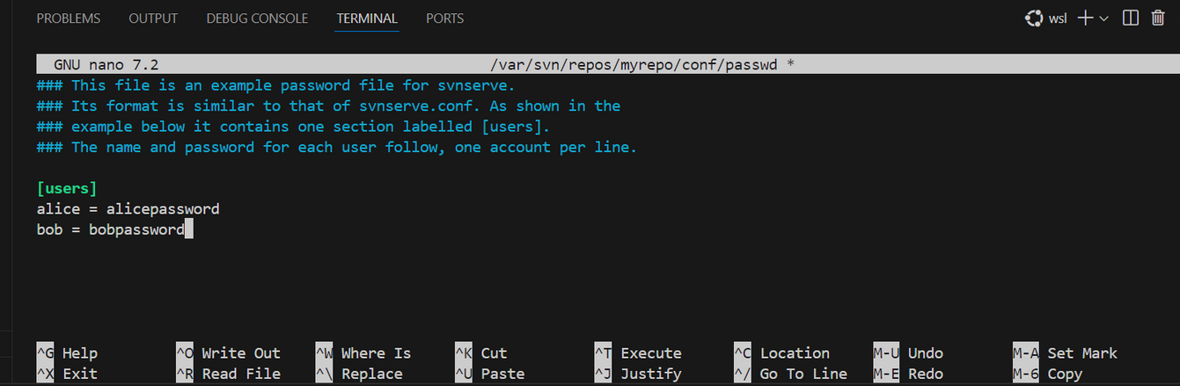
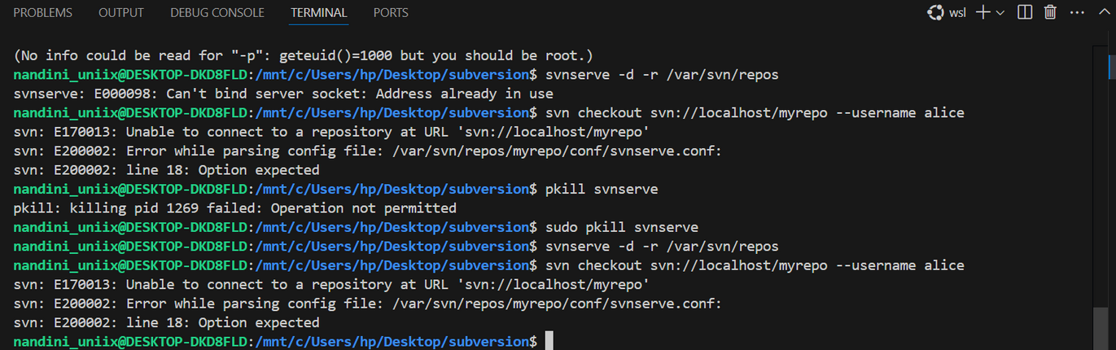
3. Commit changes

Slide 8
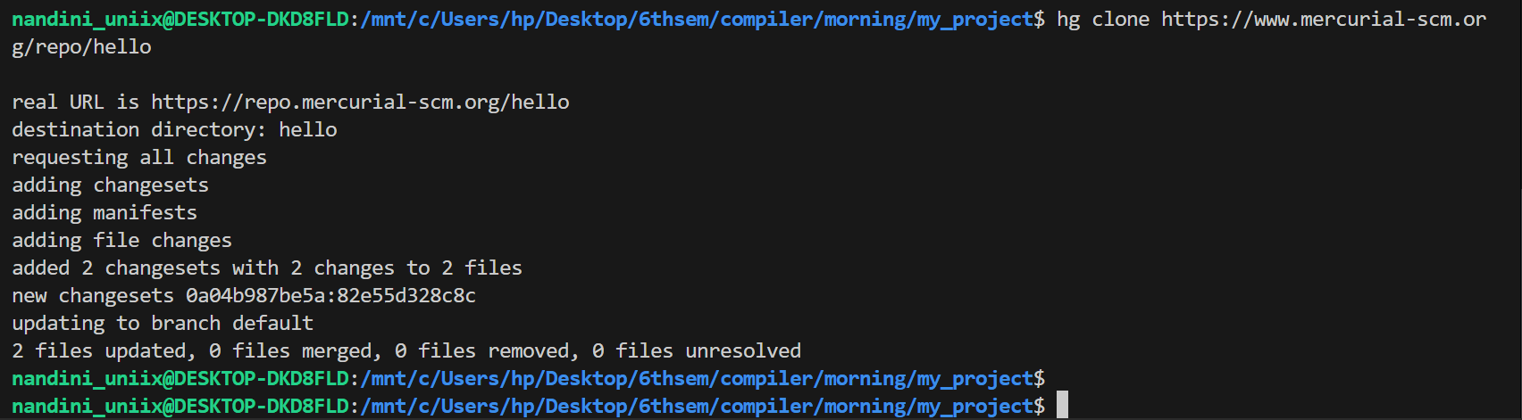
4. Clone a Remote Repository:
hg clone https://www.mercurial-scm.org/repo/hello
5. Push changes to Remote
hg push

Slide 9
ADVANTAGES
Ease of Use: Simpler and more consistent commands compared to Git.
Performance: Handles large repositories efficiently.
Flexibility: Supports both centralized and distributed workflows.
Extensibility: Plugins allow customization for specific needs.
DISADVANTAGES
Less Popular: Git has a larger community and ecosystem.
Fewer Hosting Options: Platforms like GitHub and GitLab are more Git-focused.

